Slide 1

Building Human-like AI Agents -
Solving challenges around Computer Interaction, Long-Term Memory, and Agent-Agent Communication

Slide 2
Introduction
Building AI Agents
Actions and Emergent Agent Architectures
Long-Term Memory and Context Lengths
Frameworks for Building Generalized AI Systems
Future Directions for Autonomous AI Agents

Slide 3
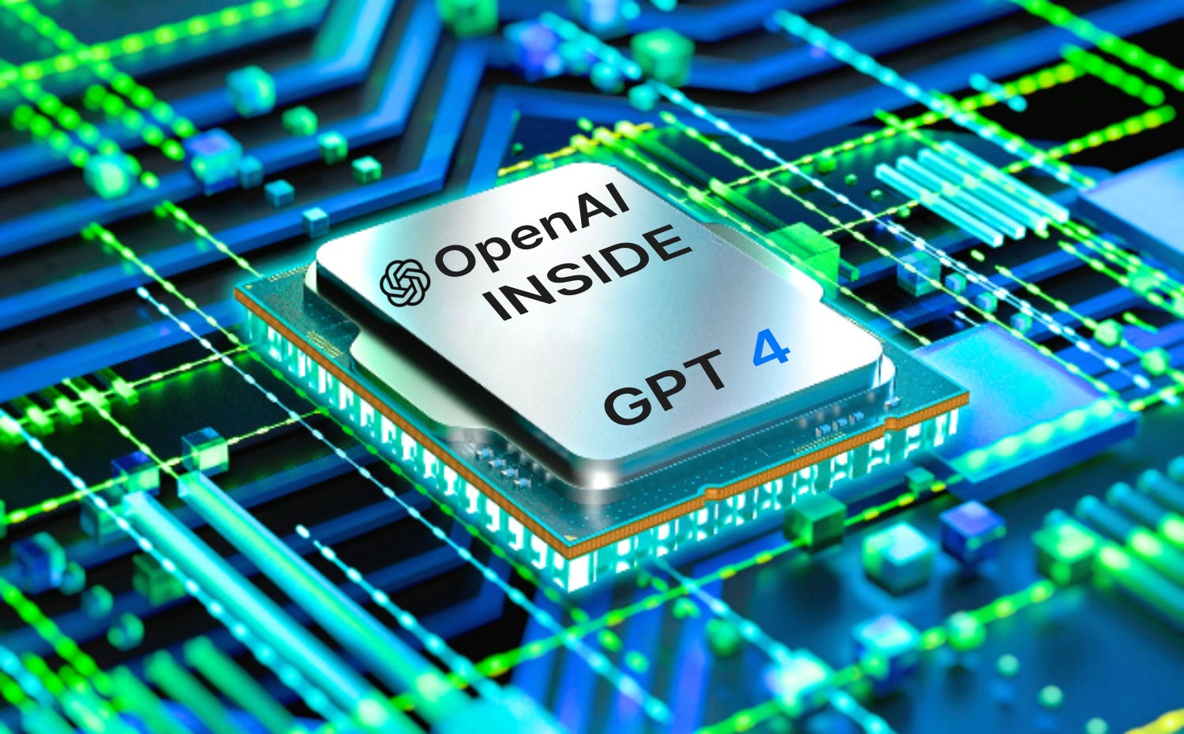
Building AI Agents
Why?
How?
Ingredients?
What can they do?
Key thesis: Humans will communicate with AI using natural language and AI will operate machines allowing for more intuitive and efficient operations
Software 3.0

Slide 4
AI Agents
Why?
A single call to a large Foundation AI model is not enough. A lot more can be unlocked by building AI systems
How?
Using model chaining, reflection & other mechanisms
Ingredients?
Memory, context length, personalization, actions, internet access…
What can they do?

Slide 5

MULTI·ON
Multiple Utility AI Language Tool for Internet Operations and Navigation (MULTION)
Agent with full R/W access to the internet
Name Origin: from Quantum Physics (neutron, muon, fermion, ...)

Slide 6
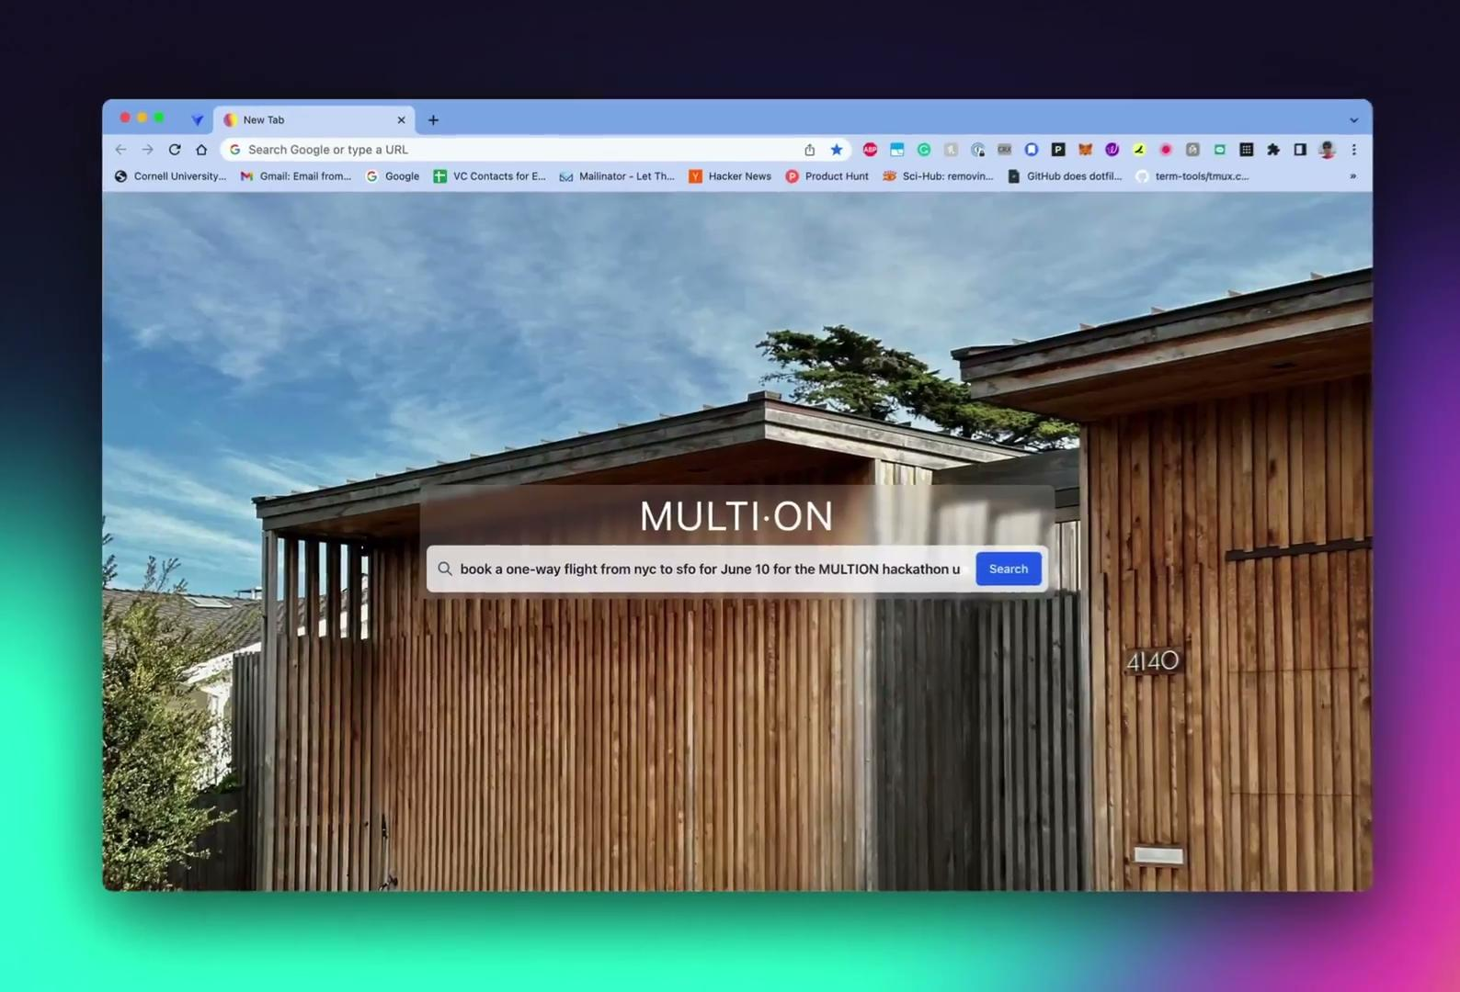
The first flight to be fully booked by an AI
MULTI·ON

Slide 7
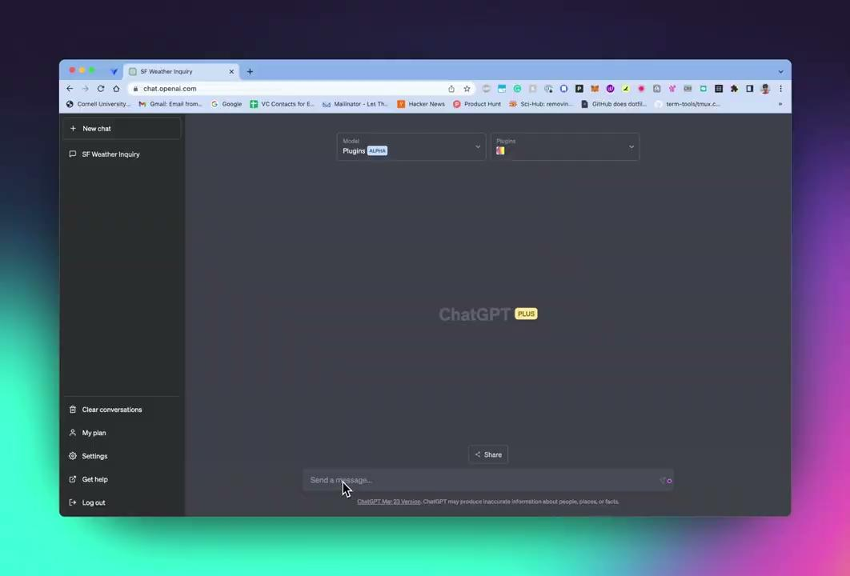
MULTI·ON

Slide 8
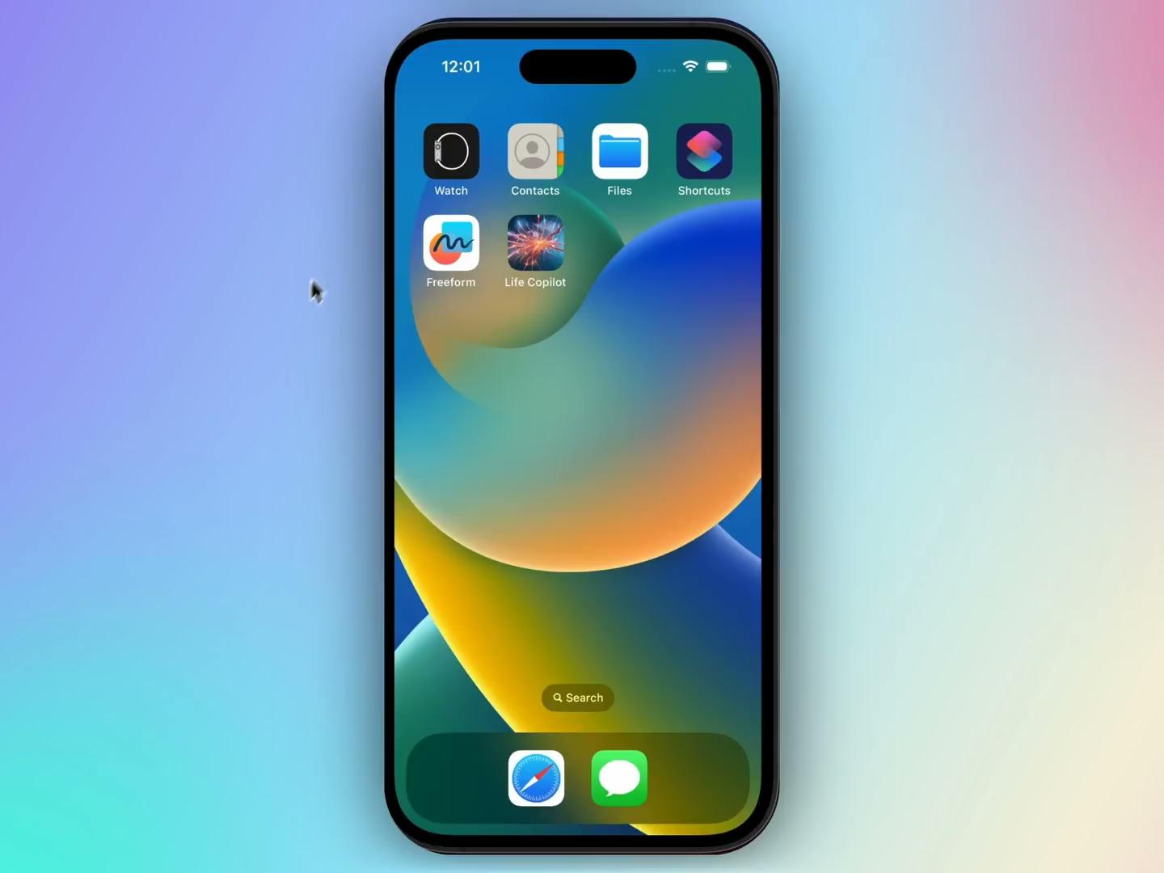
MULTI·ON - Mobile Platform
Can be present on any device & provide seamless interaction to the AI using a natural human interface to efficiently get your tasks done for you!

Slide 9
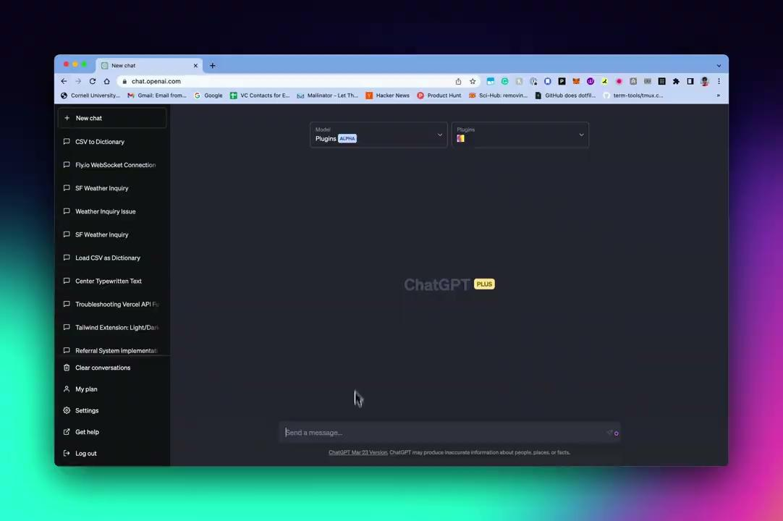
MULTI·ON - Coding example

Slide 10
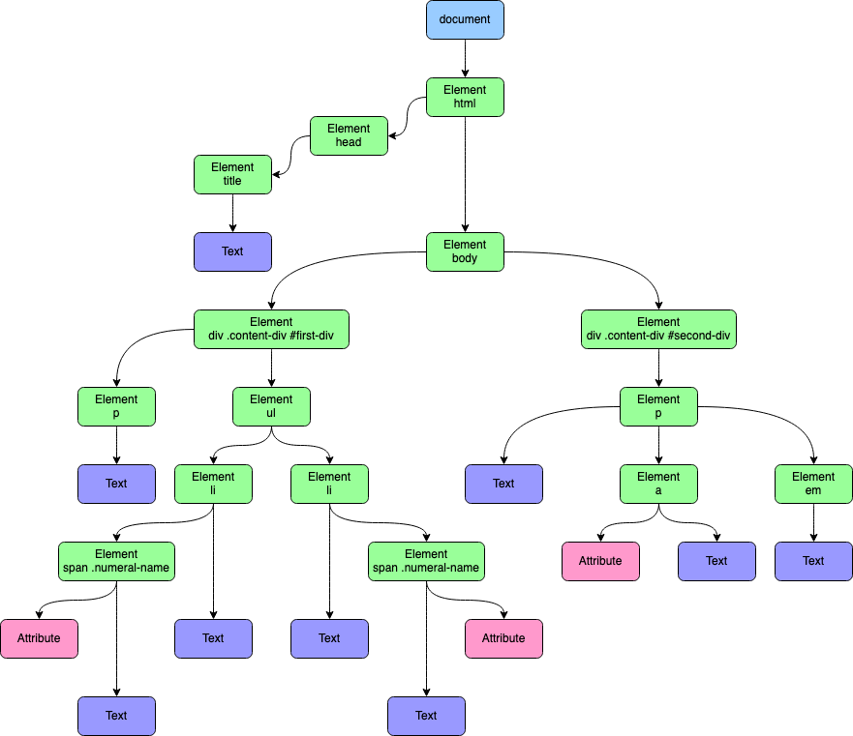
MULTI·ON Working
Compressed DOM representations
Multimodal
Fit 90% websites in <2K tokens
Notes:
Even Google.com full Html DOM is 110K tokens

Slide 11
Compute & Memory
(Rest of talk is general & not related to MULTION)

Slide 12
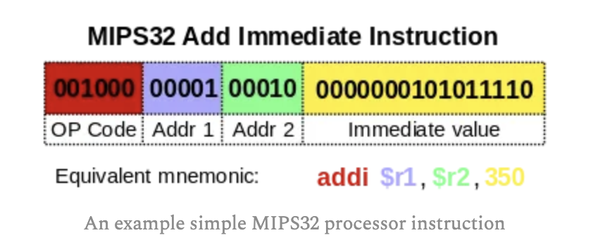
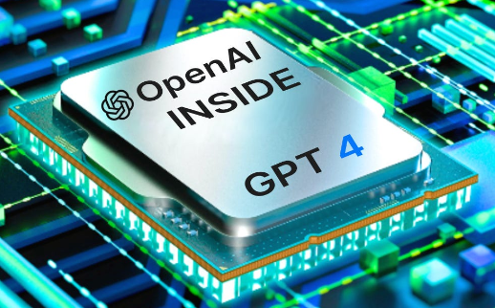
AI Models as Neural Compute
AI Model
Input Tokens
(max token size)
Output Tokens
(max token size)

Slide 13
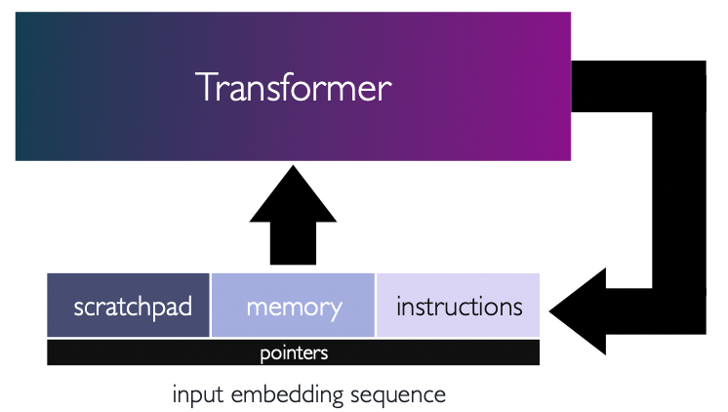
AI Models as Neural Compute
Looped Transformers

Slide 14
Model Context Length
Works as Buffer or short-term memory
Useful to have long context length sizes (32k+)
Longer context length is not Panacea!
Still need to save to a memory buffer for stateful behavior
Tasks can be hierarchically decomposed instead of being a monolith
(Dense) Attention mechanisms may suffer from Curse of Dimensionality due to context lengths: Distances between points tend to be similar in high-dimensions. As N increases higher likelihood that #N attention weight vectors will be similar to each other.
Reduced expressivity: If the dot products of attention weights and values become too similar, the model may struggle to differentiate and weigh the importance of different input tokens effectively.
Notes:
A close analogy is punchcards

Slide 15
Long-term Memory
Memory
Works similar to disk (long-lived & persistent)
Mechanisms
Embeddings
Retrieval models
Open Questions:
Hierarchy
Temporal Coherence
Structure
Online adaptation
Notes:
A functional comparison is Hippocampus area of the brain

Slide 16
Agent Architectures
Notes:
Instead of models we need systems

Slide 17
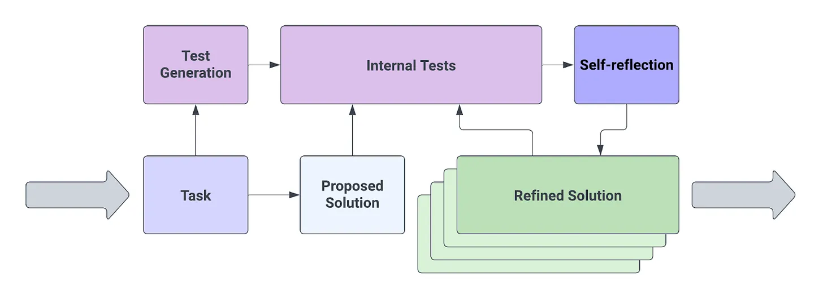
Reflection: Self-Criticism & Refining

Slide 18
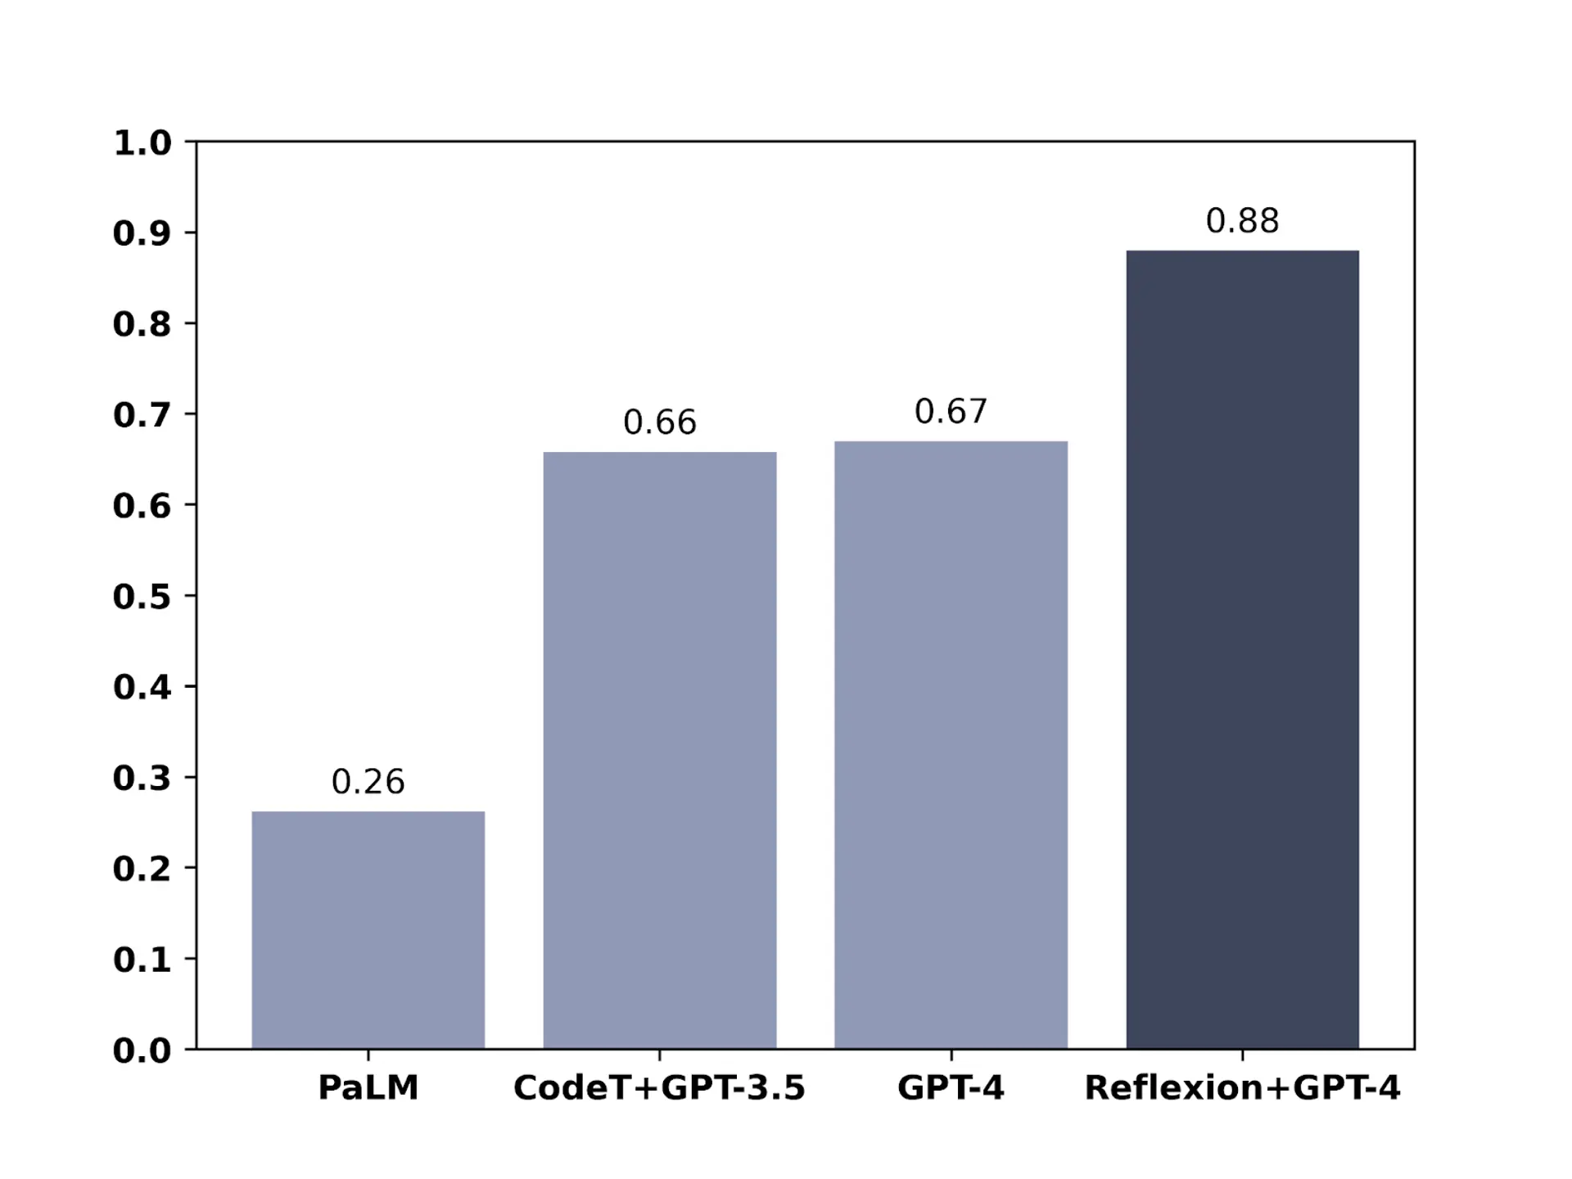
On the HumanEval coding test, GPT-4 went from 67% to 88% accuracy, an impressive leap, using self-reflective loops (Northwestern University/MIT)

Slide 19
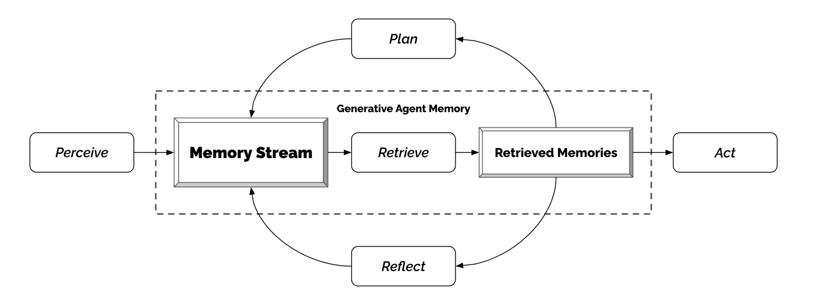
Stanford Simulcra

Slide 20
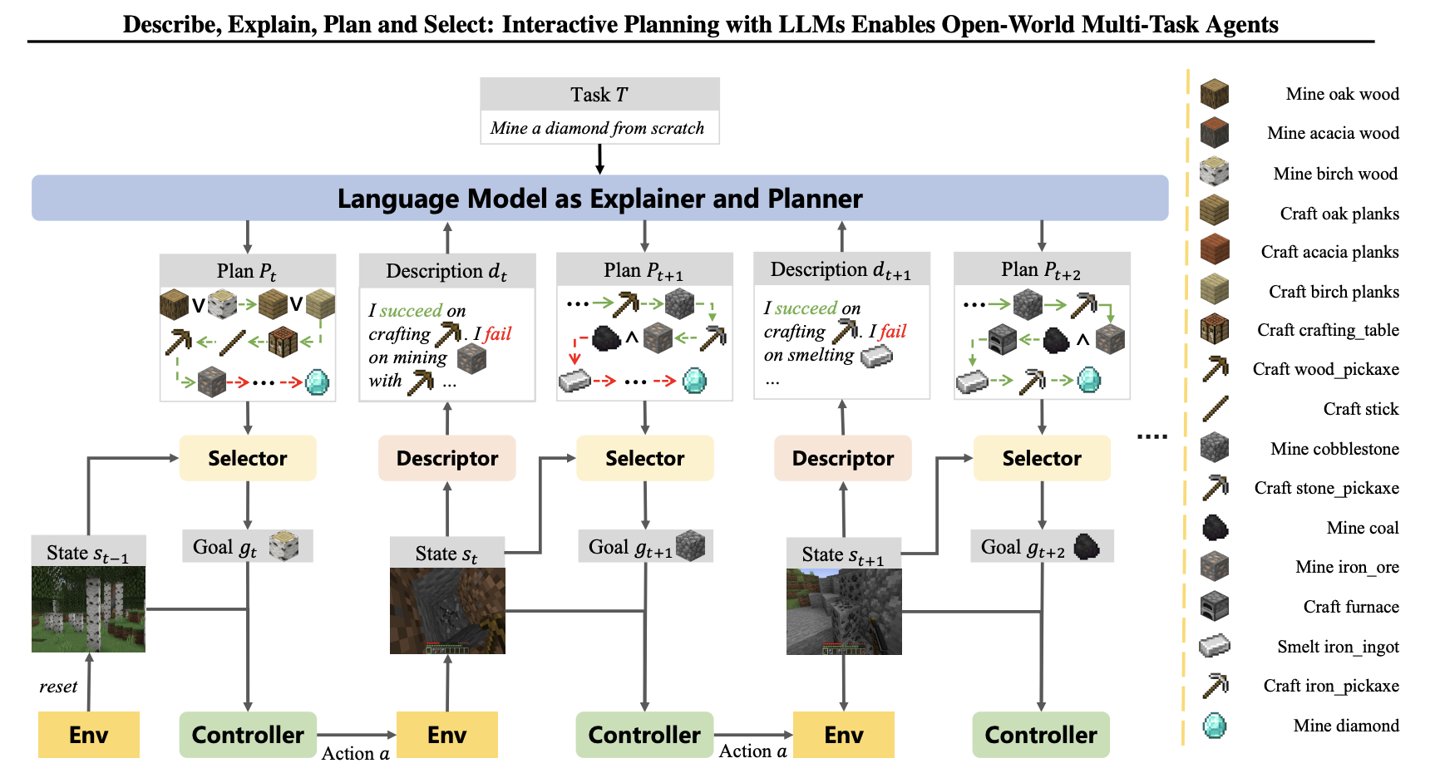
DEPS: SOTA AI Agent for playing Minecraft

Slide 21
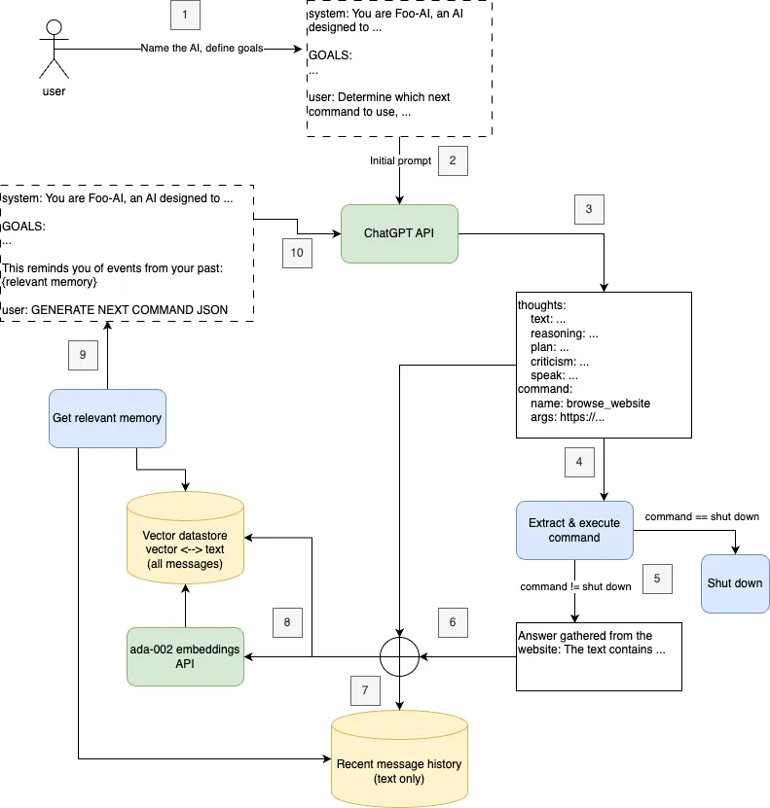
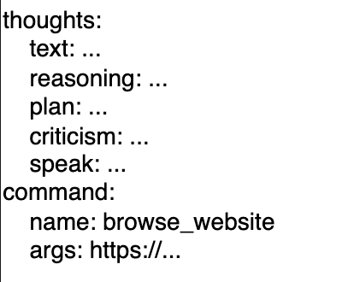
AutoGPT
Planning
Task Executor
Critic

Slide 22
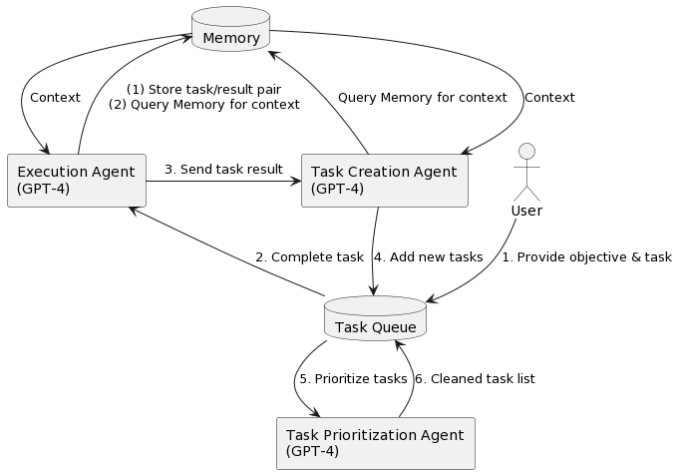
BabyAGI
Resembles a task Scheduler in an OS!!

Slide 23
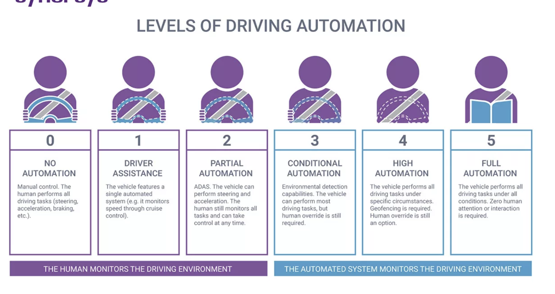
Key Issues with Autonomous Agents
Reliability
Looping & Plan Divergence
Testing & Benchmarking
Real world-deployment & Observability
How do we trust a fully autonomous AI system
How do we build in human overrides

Slide 24
Divergence
Actual path
Ideal Path
AI Agents like AutoGPT don’t know how to correct on making a mistake!
Notes:
Looping and tendenc

Slide 25

Building Generalized AI Systems
Inner thoughts
Web
Rules
Task Engine
Task
Router
Chat Interface
Apps/Tools
User
Reflection
Local Index
Result
Neural Computer

Slide 26
Future Directions
Building personalization
Error correction mechanisms & better agent frameworks
Security & user permission models
Sandboxing & deployment in risky settings
Fleet of AI Autonomous Agents

Slide 27
Conclusion
We are transitioning from AI models (stateless) to AI systems (stateful)
Key issues around Reliability & Real-world deployment risks

Slide 28
Thank you!

